Slide 1

Project 5 Faster, Better, Stronger… but did they survive?
Byron Allen
Data Science Student at General Assembly
19 October 2016

Slide 2
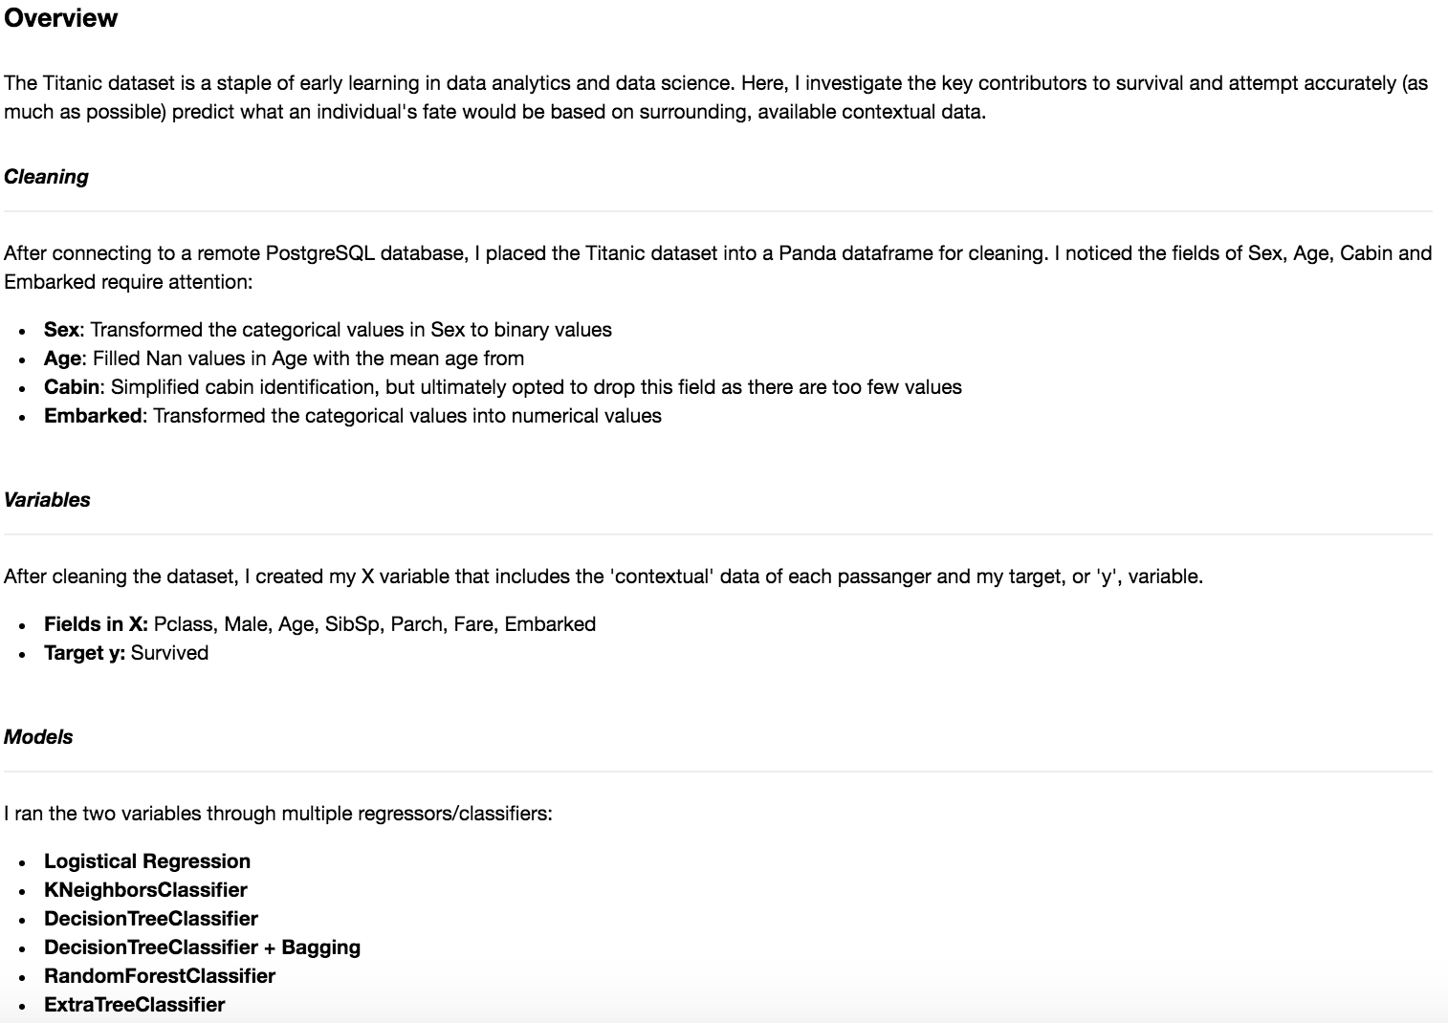
Overview

Slide 3
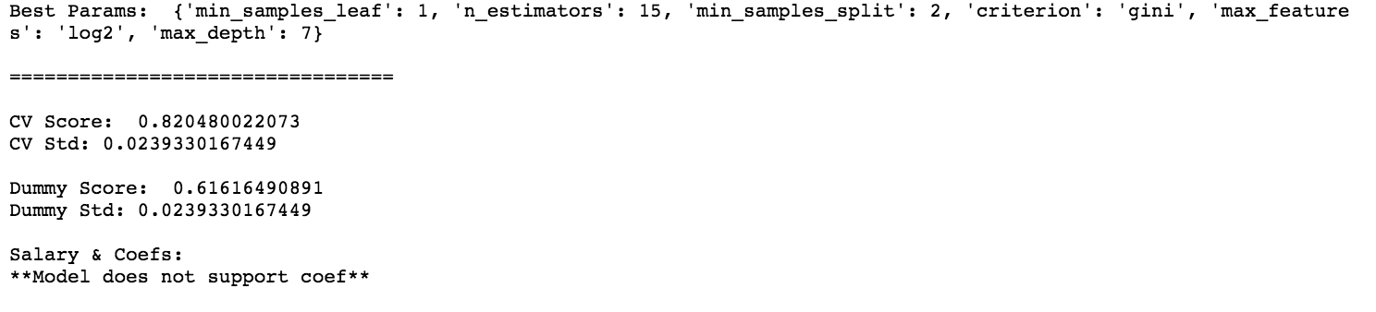
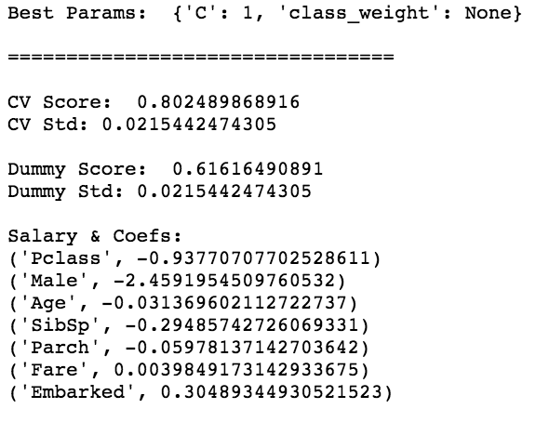
Optimized Best Models
Random Forest
Logistic Regression

Slide 4
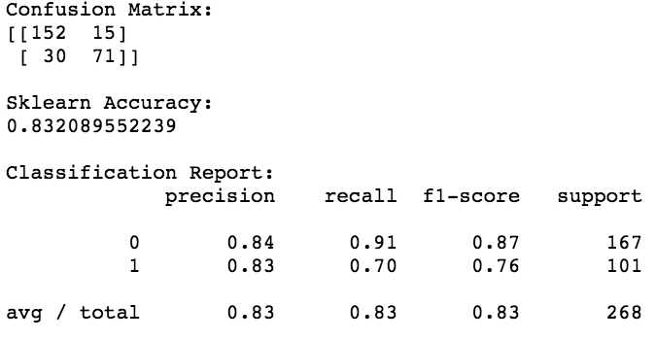
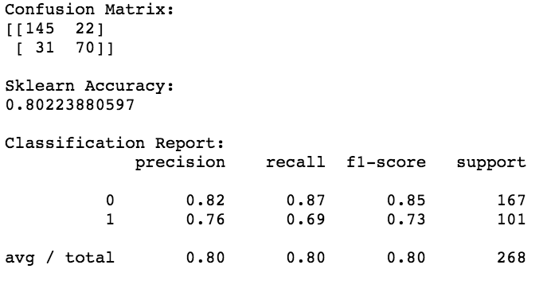
Final Reports
Random Forest
Logistic Regression

Slide 5
Visualize ROC Curves for Best Models

Slide 6
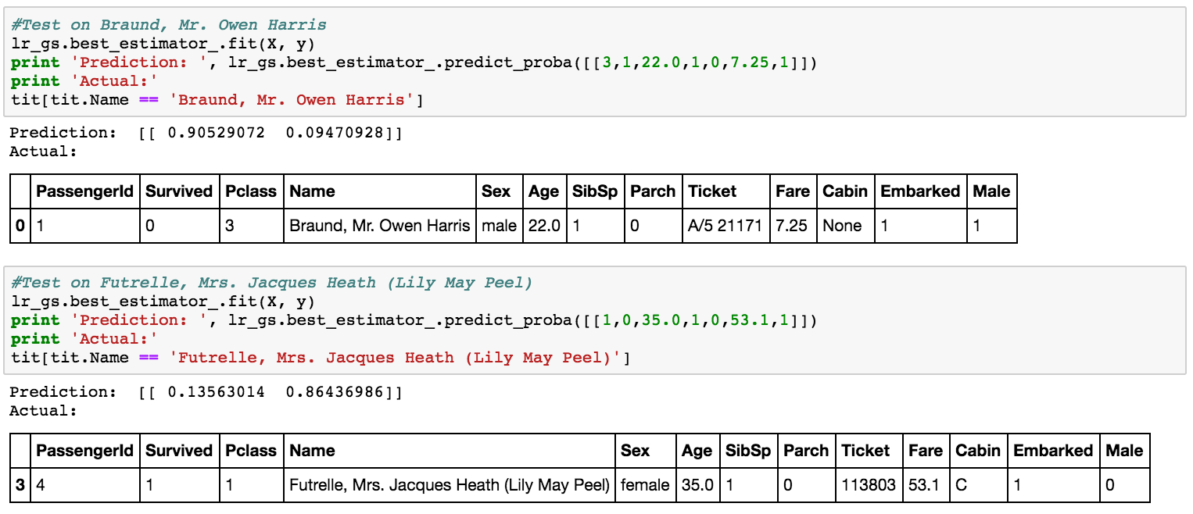
Did They Survive?

